Slide 1
The Product Recommendation for H&M
Course: BIA 679
Instructor: Dr. Mohammad Nikouei

Slide 2


Slide 3
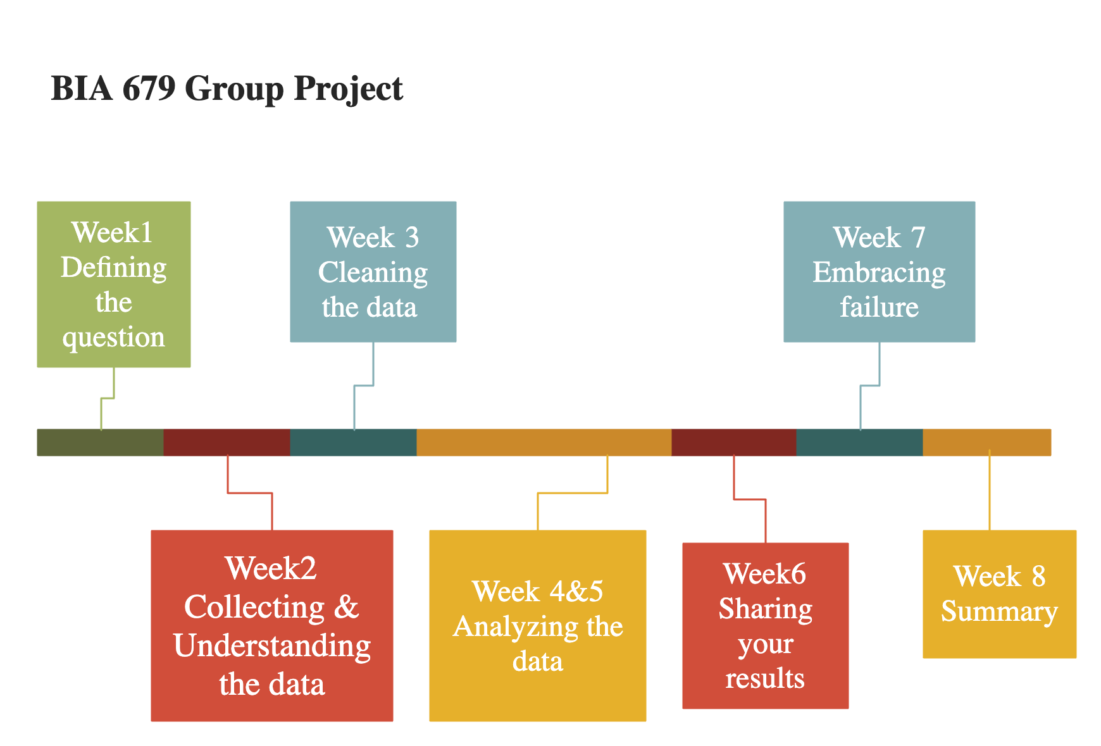

Slide 4
What’s New?
Load to AWS
Keep Optimizing Model

Slide 5
Difficulty
Overtime during the modeling
When tuning the parameter
Development environment not used to
Missing functions

Slide 6
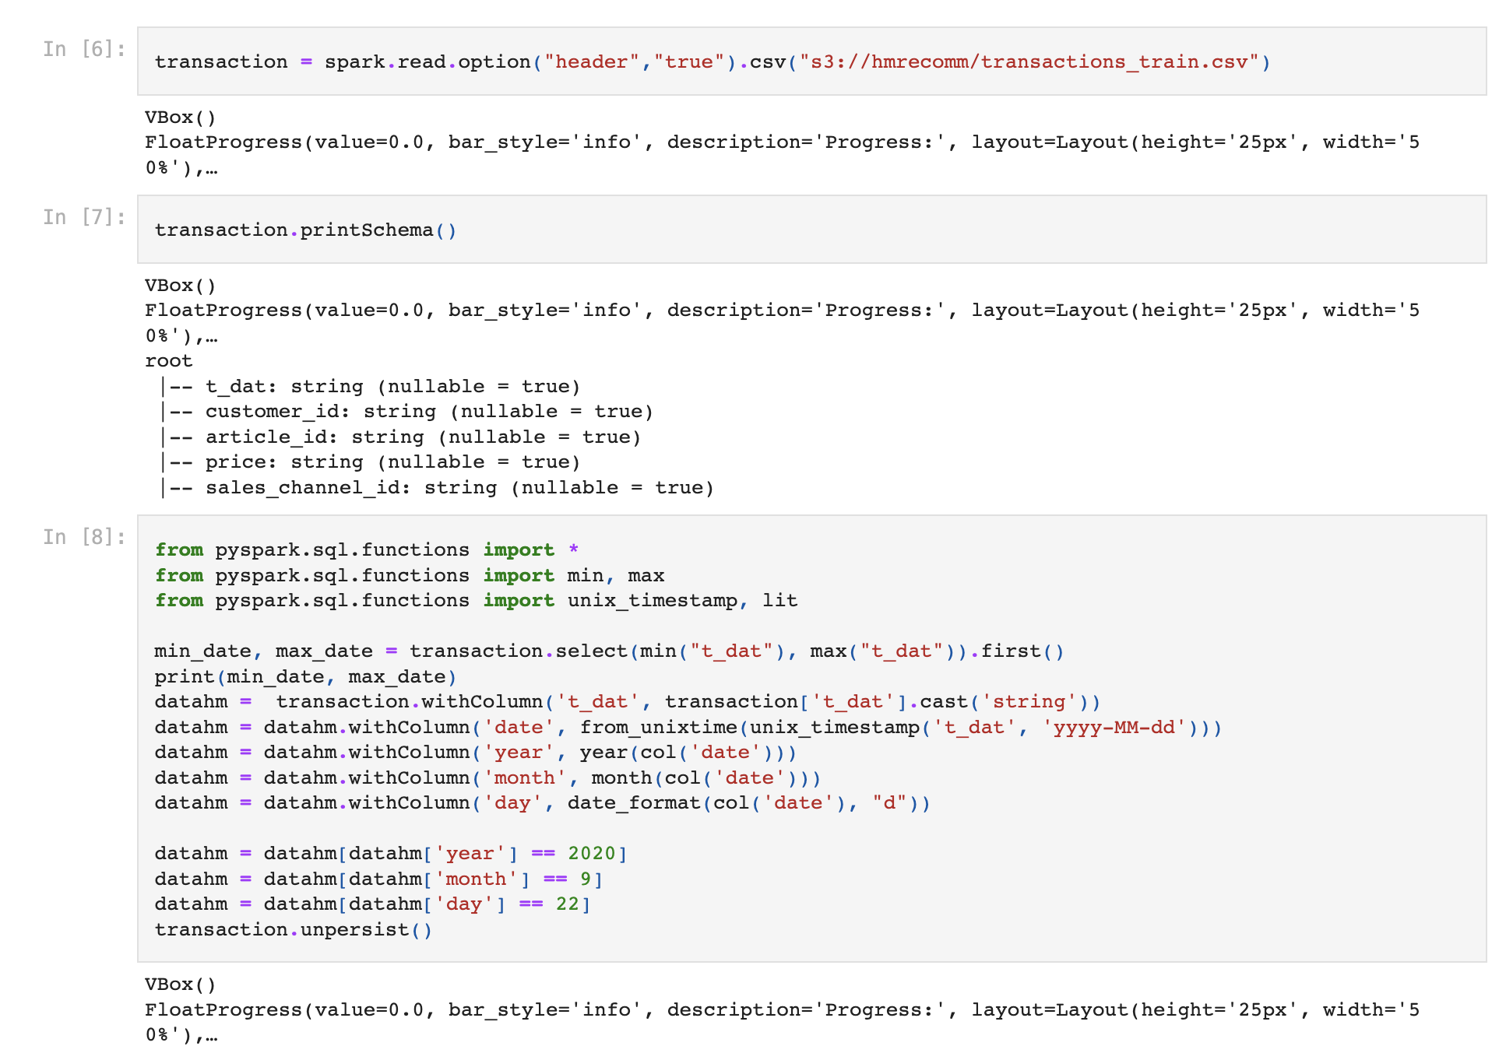
Run the code with PySpark in AWS

Slide 7
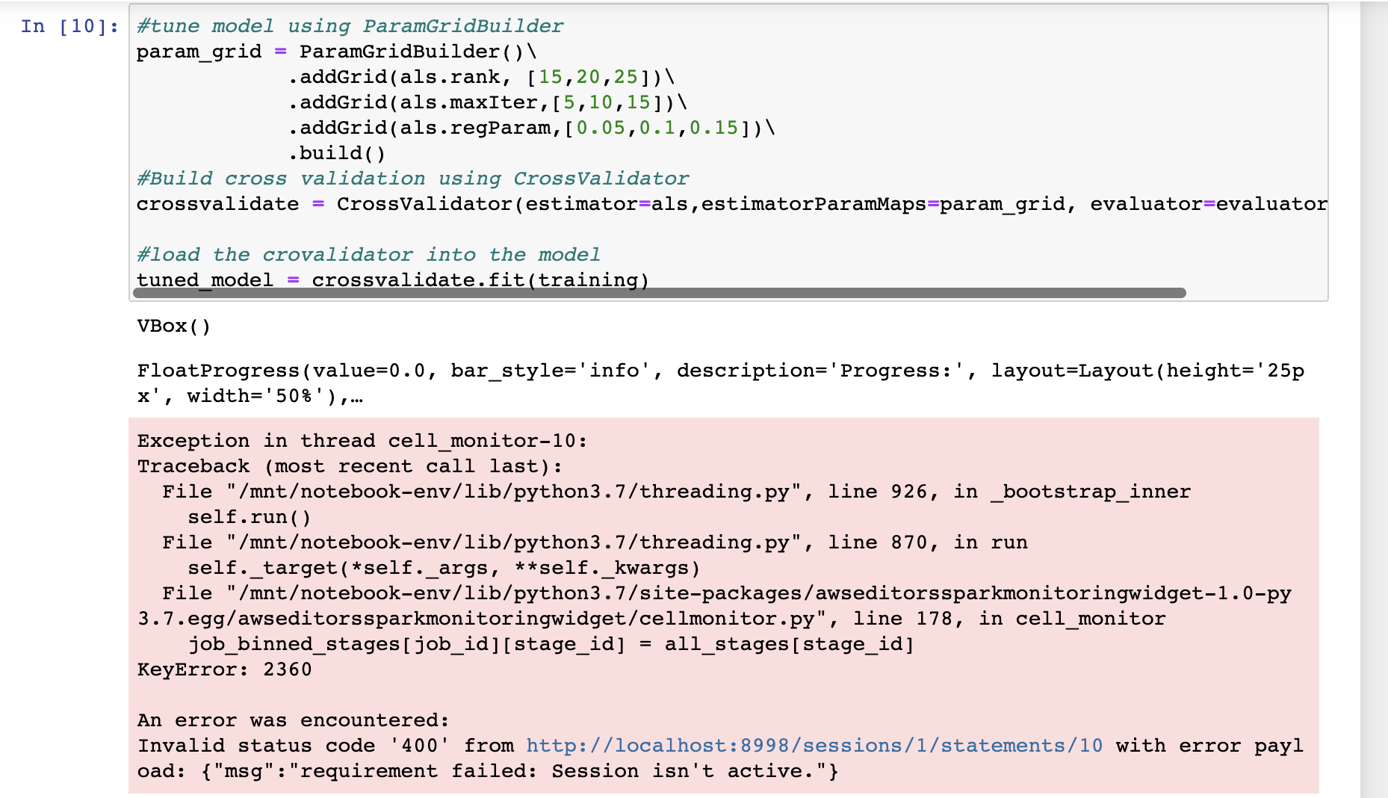

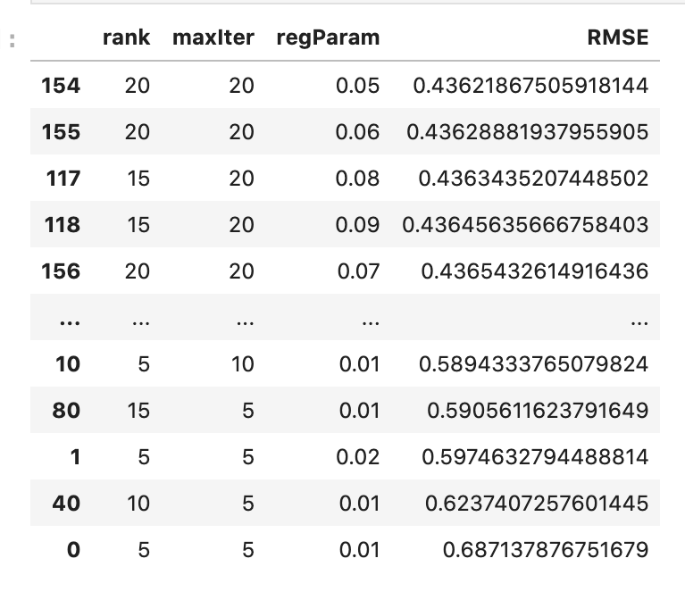
Using the different regParam cause the time out error in the AWS
Last week, local running result shows the regParam = 0.005 in best model.
Therefore, regParam = 0.005

Slide 8
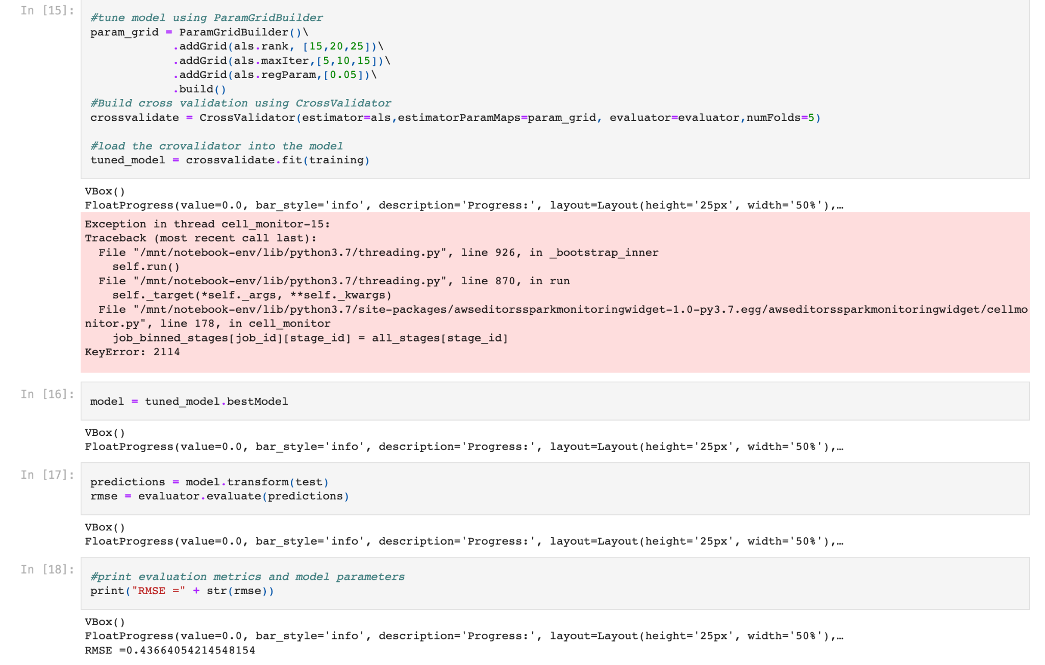
Use ParagGridBuilder to find the best model with 3 different rank and maxIter and rerParam = 0.005
RMSE = 0.436

Slide 9
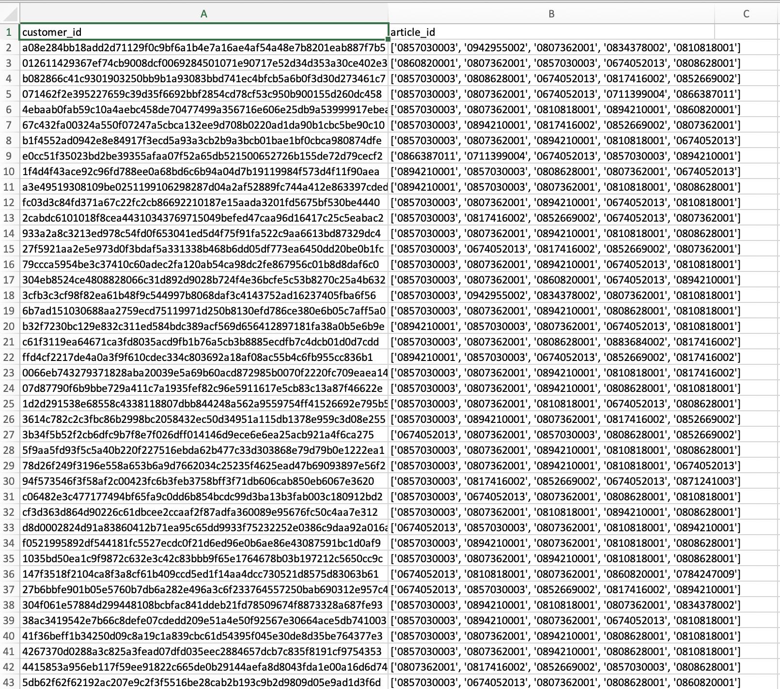
Output the result
Each customer have 5 recommend product

Slide 10
What’s Next?
Model building:
Optimize the model
Link the article ID with product classified name
Considering the price level when doing recommendation

Slide 11
Modeling
https://github.com/tychen17/The-Product-Recommendation-for-H-M

Slide 12
Reference
Zhao, Xuesong. “A Study on e-Commerce Recommender System Based on Big Data.” 2019 IEEE 4th International Conference on Cloud Computing and Big Data Analysis (ICCCBDA), 2019, https://doi.org/10.1109/icccbda.2019.8725694.
Jessica Young | Feb 18, 2022, et al. “US Ecommerce Grows 14.2% in 2021.” Digital Commerce 360, 16 Sept. 2022, https://www.digitalcommerce360.com/article/us-ecommerce-sales/.
“H&M Personalized Fashion Recommendations.” Kaggle, https://www.kaggle.com/competitions/h-and-m-personalized-fashion-recommendations/data.
Liao, Kevin. “Prototyping a Recommender System Step by Step Part 2: Alternating Least Square (ALS) Matrix Factorization in Collaborative Filtering.” Medium, Towards Data Science, 19 Nov. 2018, https://towardsdatascience.com/prototyping-a-recommender-system-step-by-step-part-2-alternating-least-square-als-matrix-4a76c58714a1.
“Alternating Least Squares.” Apache Flink 1.2 Documentation: Alternating Least Squares, 19 Oct. 2022, https://nightlies.apache.org/flink/flink-docs-release-1.2/dev/libs/ml/als.html.

Slide 13
Thank you

